Slide 1
CLC – Leadership Styles
Presented By: Gustavo Alvarez, Jewel Norton & Stacey Thompson
PUB 660
December 2, 2020

Slide 2
Learning Objectives
You will learn about group members leadership styles
You will learn about strengths and weakness of democratic leadership
You will learn about why public health professionals should be aware of personal leadership style, traits and practices
You will learn how integrating the tenets of servant leadership can empower and influence others
You will learn why leaders who practice servant leadership have a strong understanding of their personal leadership traits can be successful
Notes:
As a team coming together, Gustavo, Jewel, and Stacey will share their leadership styles, traits, and practices. This presentation will also present on the strengths and weakness of their democratic leadership; why public health professionals should be aware of personal leadership styles, traits, and practices; how integration of tenets of servant leaderships can empower and influence others; and why leaders who practice servant leadership have a strong understanding of their personal leadership traits can be successful.

Slide 3
Gustavo - Democratic Leadership Style
Traits
Caring
Creative
Truthful
Innovative
Honest
Giving
Inspiring
Sincere
Practices
Exudes honesty and trust to team members.
Values and respects points of views.
Creativity and willingness to work together with team members.
The love to serve is clearly represented.
Notes:
The leadership style assessment strongly shows the type of leader of Gustavo. He has a democratic leadership style, which conveys with the traits that listed above. Gustavo exudes these traits, feels that every leader must possess such traits and excel to become a better person each and every day.

Slide 4
Jewel - Democratic Leadership Style
Traits
Intelligent
Independent
Creative
Honest
Fair
Loyal
Loving
Caring
Encouraging
Unselfish
Obedient
Practices
Promote free-flow of ideas
Inspire trust and respect
Emphasis morality and value
Competence
Honest and open minded
Notes:
Jewel’s leadership style falls under the democratic or participative leadership style. Based on a the leadership style she is a leader who does have the final say in decisions, however it is very important that she listens to her team and takes their ideas into consideration. As a leader, Jewel believes it is important that she builds a trustworthy relation with her team, so they feel welcome to share their opinion with leadership and they know that leadership does value their opinions.

Slide 5
Stacey - Democratic Leadership Style
Traits
Practices
Honest
Forward-looking
Dependable
Supportive
Fair-minded
Determined
Cooperative
Ambitious
Caring
Loyal
Self-controlled
Independent
Must be knowledge synthesizers
Need to be creative
Foster and facilitate collaboration
Are systems thinkers
Must set priorities
Need to form coalitions and build teams
Act as a colleague, a friend, and a humanitarian
Notes:
Stacey also has a democratic leadership style. She likes to involve team members in the process and build trust amongst those involved in the program efforts. When people feel engaged, valued, and acknowledged this allowed the activities, objectives, and goals to be met. People also have valuable insight into a problem or process and their creative input and fresh ideas allow progress be done together rather than alone.
Some commonalities among Gustavo, Jewel, and Stacey is their democratic leadership style. Although each member have honesty and caring as traits that are similar, all possess traits that they were learned through their experience as a public health professionals. The practices that each member also demonstrate include is upholding oneself to be honest, respectful, creative, and inspiring.

Slide 6
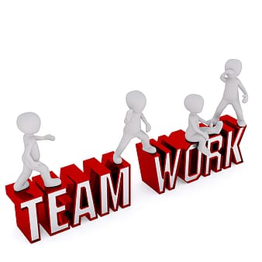
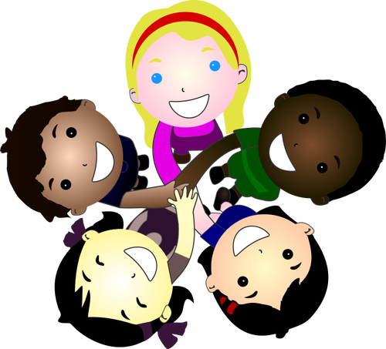
Democratic Leadership Style
Strengths:
Listen to others
Build Trust
Actively Involve others
Work together
Confidence
Innovate
Notes:
The commonalities between group members' strengths:
It is very important that to listen to our team and take their ideas into consideration.
As a leader it is important to build a trustworthy relation with our team, so they can feel welcome to share their opinion with us and they know that we value their opinions. Building trust between us and those we work amongst is a strength.
We believe that actively involving our team members in the process. When people feel engaged, valued, and acknowledged this allows the activities, objectives, and goals to be met. People also have valuable insight about a problem or process and their creative input and fresh ideas allow us to progress together rather than alone. Staff and team members should also be able to express their opinions and feelings.
It is imperative to work together too. When we plan as a team we can create the best patient quality and positive outcomes. It is known that when there is trust, confidence, teamwork collaboration, and knowledge, things can work better and efficiently.

Slide 7

Democratic Leadership Style
Jewel’s Weaknesses:
Requires extra time to implement a decision
Relies on the expertise of the team to be useful
Gustavo’s weaknesses:
Not everyone’s point of view will be the right one (different points of views may cause issues).
Sometimes encourage workplace procrastination
Stacey’s weaknesses:
Avoid conflict/confrontation
Sometimes ineffective in a crisis
Notes:
Compare the personal leadership styles of your group members, including commonalities between group members' strengths and weaknesses.
As leaders that leans more to the democratic leadership style it allows us to take our team ideas and opinion into consideration before making a decision, however this sometimes can be a disadvantage or weakness to this leadership style.
The first weakness Jewel faces as a democratic leadership style is that she require extra time to implement a decision. This is because their are direct reports involved in the decision-making process, which require more time and resources to make the correct choice. Also, if this process is ineffective, then it can obstruct productivity and decrease the pace of the workflow.
Jewel also relies on the expertise of the team to be useful, which is a weakness for her. One take on the leadership role because they believe that they have the capability to make a final decision when needed, however democratic leader relies on the expertise of their team before making a decision. This can then work against us because sometimes the team members does not have the experience needed to give a meaningful feedback. (ConnectUs, 2019)
Gustavo weakness is that he sometimes encourage workplace procrastination. The fact that everyone are given opportunity to share their experiences, voice their opinions, or offer their perspective, the time it takes to reach a final decision can become a liability (ConnectUs, 2019). Also not everyone’s point of view will be the right one which then causes issues and delay final decisions.
Stacey’s weakness is that she avoids conflict or confrontation. At times deadlines has to be met which comes down to the wire because of the feedback received from others on projects or this could be because management needs to approve the final decision; and sometimes she can be unmotivated to lead especially if she is unsure. In life there is always a crisis that require immediate attention and decision to be made and as democratic leaders who relies on the inputs to make a final decision this works against us (ConnectUs, 2019).

Slide 8
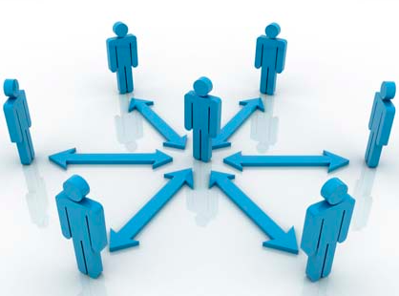
Importance for public health professionals to be aware of their personal leadership style, traits, and practices
Style
The ability to guide
The ability to inspire confidence
Direct or influence people
To achieve vision and goals
Traits
Reflects in one’s leadership style
Enhance one's effectiveness
Kim Dae-Jung- WordPress.com
Notes:
It is important for public health professionals to be aware of their personal leadership style, traits, and practices because traits as a future public health professional because it is how you inspire other craft and achieve a vision and goals. They are three leader styles, and they are democratic approach which is participative and consensus, contingency approach which read the situation and adapt accordingly and transformational approach which are rational and creative. The knowledge of personal leadership style and skills can help one navigate and lead in the public health system because it is the ways in which a leader views leaderships and performs it in order to accomplish their goals (Canadian Public Health Association, 2016).
Leadership styles are important to understand as a future public health professional because not all organizations will operate the same, plans and programs may be implemented differently, and staff may have different motivation depending on the way a leader provides direction. And lastly it is knowing leadership style is knowing if the leader will bring out the best in people known as multipliers or if a leader diminishes people.
Traits are important to understand as a future public health professional because traits can be reflected in the leadership styles of individuals. Traits can be innate qualities or a combination of innate qualities with qualities that can be learned. Traits can enhance the effectiveness of a leader as well (Rowitz, 2014).

Slide 9
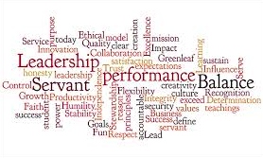
Integrating the Tenets of Servant Leadership
Serve First
Build Trust
Live Your Values
Listen to Understand
Think about your Thinking
Add Value to Others
Demonstrate Courage
Increase your Influence
Live your Transformation
www.executiveexcellence.com
"One who posses a clear vision, is courageous, has integrity, honesty, humility and clear focus. He or she is a strategic planner and believes in teamwork. Great leaders help people reach their goals, are not afraid to hire people that might be better than them and take pride in the accomplishments of those they help along the way” -Gleeson, 2017.
Notes:
Public health professionals can benefit from integrating the tenets of servant leadership to empower and influence others as they lead. Servant leadership is a daily practice of behaviors. To be a servant leader you must first be a servant. You should focus on the needs of your team member, before considering your own. Servant leaders acknowledge perspectives, give them the support they need to meet their work and personal goals, involve them in decisions where appropriate, and build a sense of community within your team. (MindTools, n.d.). Servant leaders believe at the core they are “first among equals” and will teach and learn from one’s peers. This allows everyone to do what they do well in by drawing on strengths and allowing the peer to be in the spotlight (CommunityToolBox, 2020). Building trust is asking if you are trustworthy and are you willing to extend trust to others. When you live your values, you ask yourself what are your values and are you able to define your values. Do you talk more than you listen, do you set aside distractions and are you present? These encompasses whether you listen to understand. Think about your thinking, encompasses one’s attitude. Another tenet is do you add value to others? This means are you constantly adding value and are you always taking credit? Credit should be given to the entire team. Do you demonstrate courage? In this sense are you willing to make tough decisions, follow through on the tough decisions, and do you honor your commitments? Do you increase your influence to be open and authentic with no hidden agenda? Lastly, do you live your transformation? This means when you have something, do you share it or if you need something, do you ask for it (Servant Leadership Institute, 2017)?

Slide 10
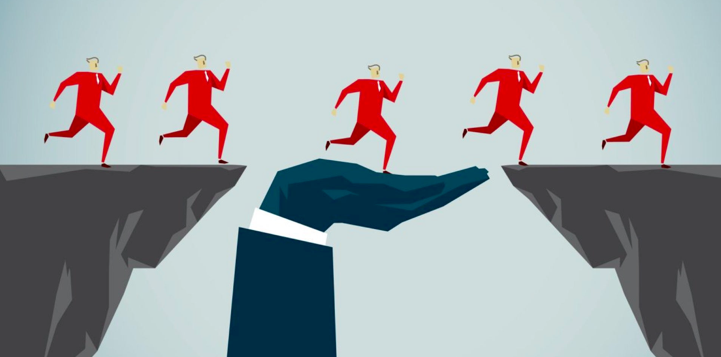
How Can Servant Leaders Successfully Lead Others
Servant leaders unite, empower and build trust.
Servant leaders exude, confidence and find innovative ways to work cooperatively.
Servant leaders build rapport and knowledge, which is transmitted to team members.
Team members show empowerment and perform at a high, innovative level.
The power of persuasion to encourage and take action.
Build strong relationships and support to achieve their work and personal goals.
www.entrepeneur.com
Notes:
Servant leaders work hard to innovate and find ways to engage, build trust, confidence and involve team members to become the best they can be. According to MindTools, n.d., “As a servant leader, you're a "servant first" – you focus on the needs of others, especially team members, before you consider your own” In other words, servant leaders must be there to fully support and encourage those under to become their best (MindTools, n.d.).

Slide 11
References
Canadian Public Health Association. (2016). Leadership in Public Health Practice. https://www.cpha.ca/sites/default/files/uploads/webinars/2016-09-14-vollman_public-health-leadership.pdf
Community ToolBox. (2020). Section 2. Servant Leadership: Accepting and Maintaining the Call of Service. https://ctb.ku.edu/en/table-of-contents/leadership/leadership-ideas/servant-leadership/main.
ConnectUs. (2019, May 20). 22 Advantages and Disadvantages of Democratic Leadership Style. https://connectusfund.org/8-advantages-and-disadvantages-of-democratic-leadership-style.
Gleeson, B. (2016, November 09). 10 Unique perspectives on what makes a great leader. Retrieved from https://www.forbes.com/sites/brentgleeson/2016/11/09/10-unique-perspectives-on-what-makes-a-great-leader/?sh=48bc9cd75dd1
MindTools. Servant Leadership: Putting Your Team First, and Yourself Second. https://www.mindtools.com/pages/article/servant-leadership.htm.
Rowitz, L. (2014). Public Health Leadership Putting Principles Into Practice, (3rd ed) [eBook edition].. Burlington, MA: Jones & Bartlett Learning. https://viewer.gcu.edu/9QVjRA
Servant Leadership Institute. (2017, January 6). Nine Behaviors of Servant Leadership [Video]. YouTube. https://www.youtube.com/watch?v=Tiq0ZmN6sq8.

